Slide 1
ML-Enhanced Partial Discharge Fault Detection in Covered Conductors
Jeffrey Egan // September 2022

Slide 2
Overview
Background Information on the Project
Quick Exploratory Data Analysis
Primer on Partial-Discharge Faults
Data Preparation – Signal Processing
Feature Extraction and Features Analysis
Machine Learning Models and Deep Learning Networks
Model Evaluation and Performance Results
Interesting Observations, Lessons Learned
Ideas for Improving / Expanding upon this Project

Slide 3
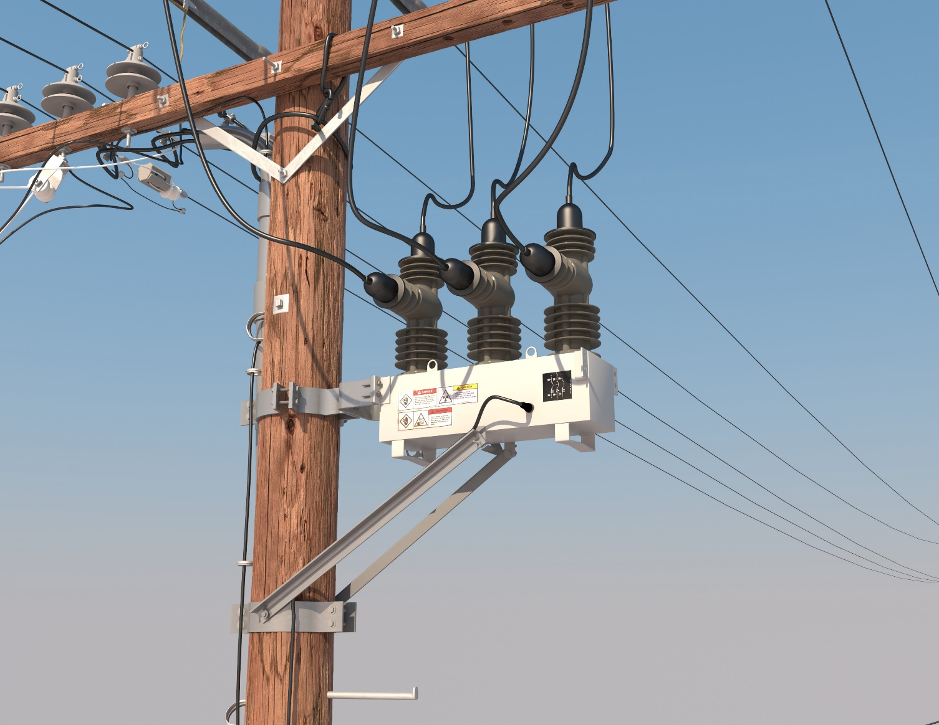
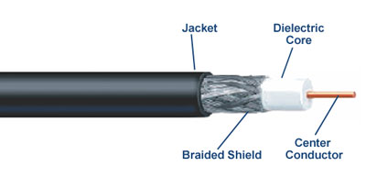

Partial Discharge Faults – Background & Motivation
Overhead, medium-voltage power lines run for hundreds of miles. These great distances make it expensive to manually inspect for damage that doesn't immediately lead to a power outage.
Degradation or rupturing of insulation systems can lead to a phenomenon known as partial discharge — an electrical discharge which does not bridge the electrodes between an insulation system completely.
Partial discharges slowly damage the power line. Left unrepaired they will eventually lead to a power outage, additional damage, and possibly even start a fire.
Meters employed to collect voltage data
Detect PD-Faults to enable proactive maintenance, avoiding service outages and reducing cost
Notes:
Overhead power lines run for hundreds of miles to supply power to cities. These great distances make it expensive to manually inspect the lines for damage that doesn't immediately lead to a power outage (like tree branches falling on lines).
These modes of damage lead to a phenomenon known as partial discharge — an electrical discharge which does not bridge the electrodes between an insulation system completely.
Partial discharges slowly damage the power line, so left unrepaired they will eventually lead to a power outage or start a fire.
The challenge is to detect partial discharge patterns in signals acquired from these power lines with a new meter designed at the ENET Centre at VŠB. Effective classifiers using this data will make it possible to continuously monitor power lines for faults – helping to reduce maintenance costs and prevent power outages.
Solid Dielectric Loadbreak Switch

Slide 4
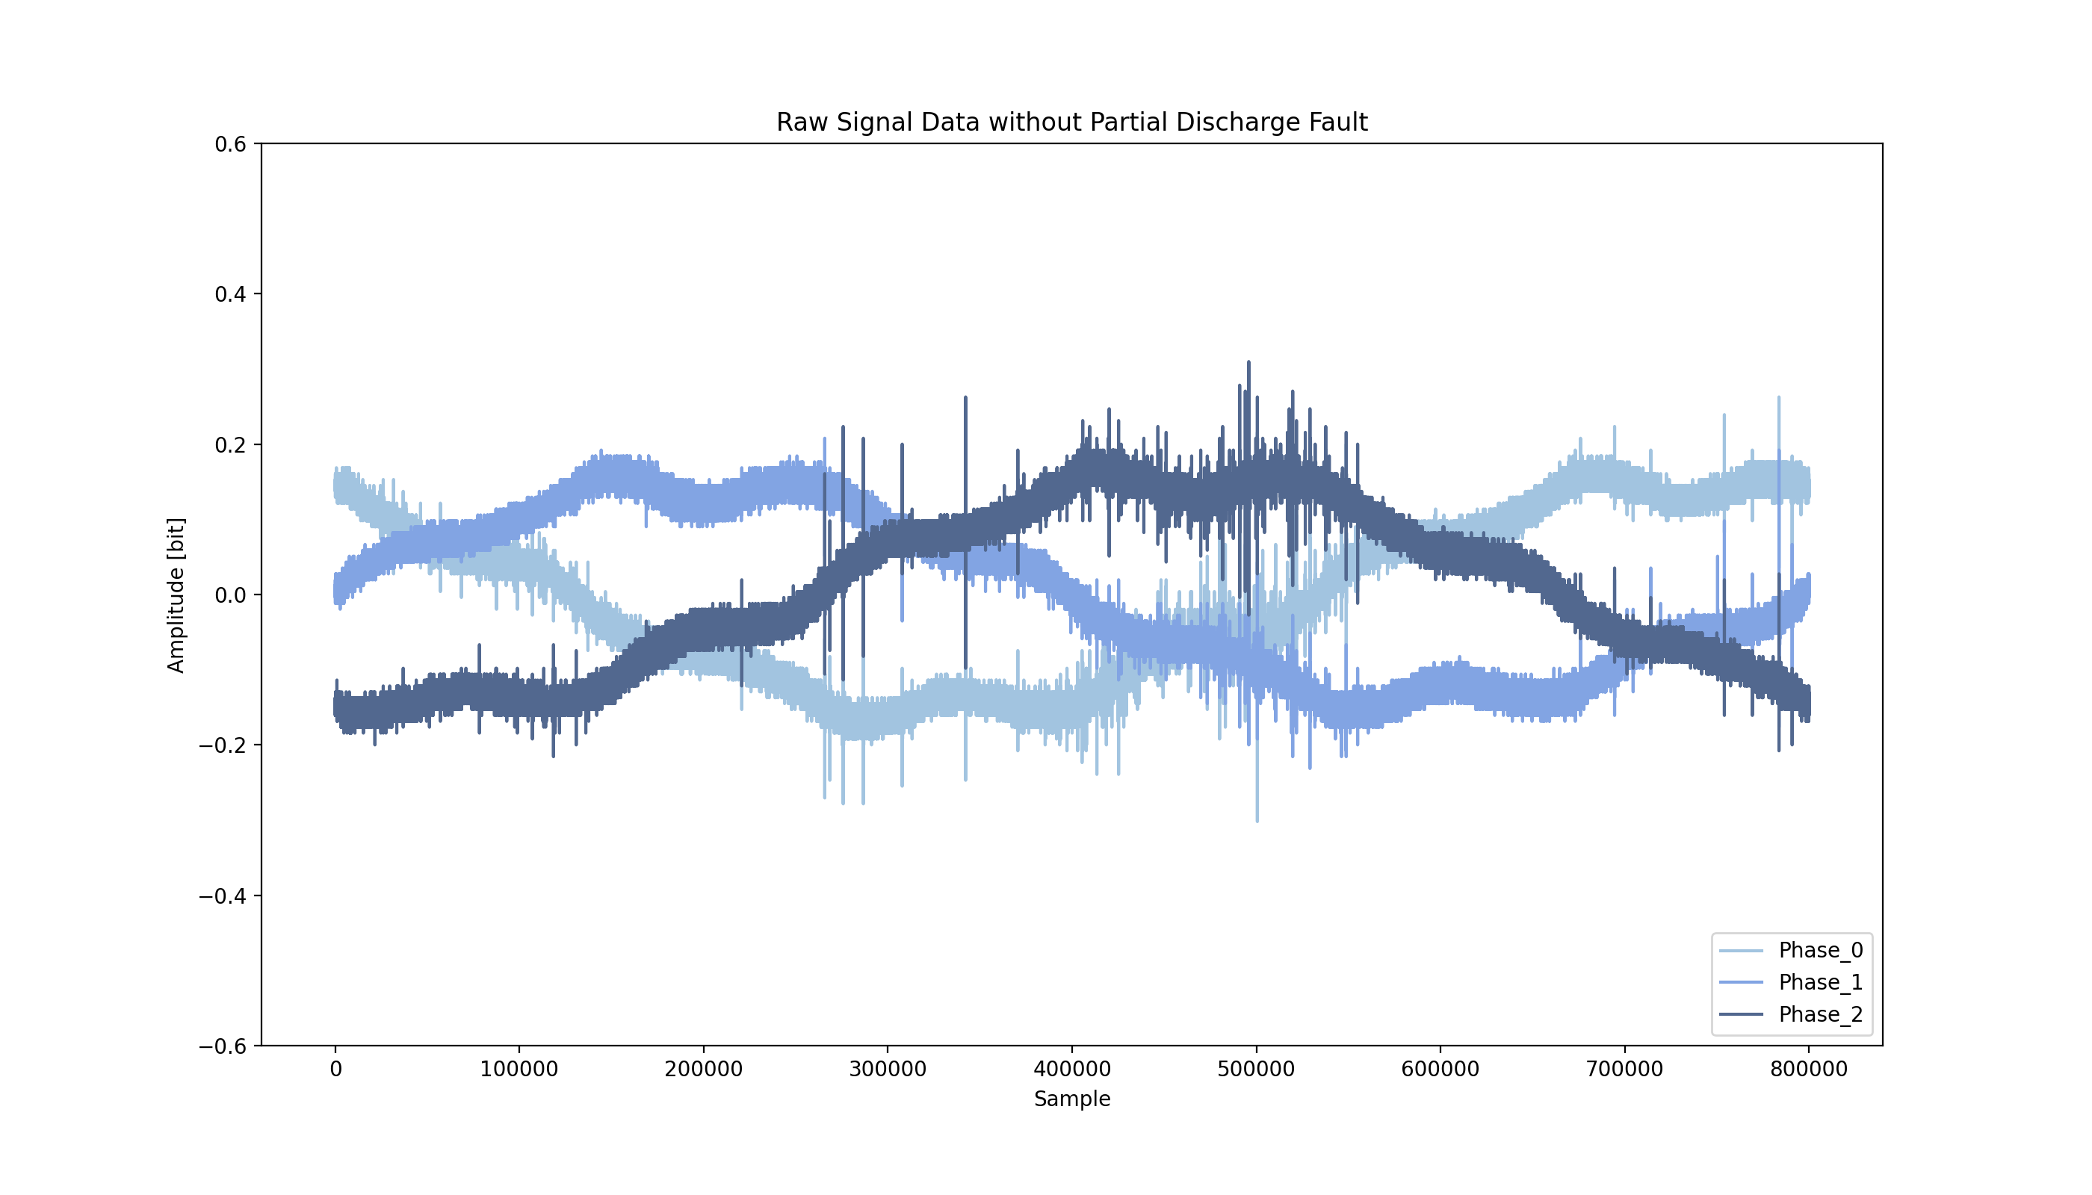
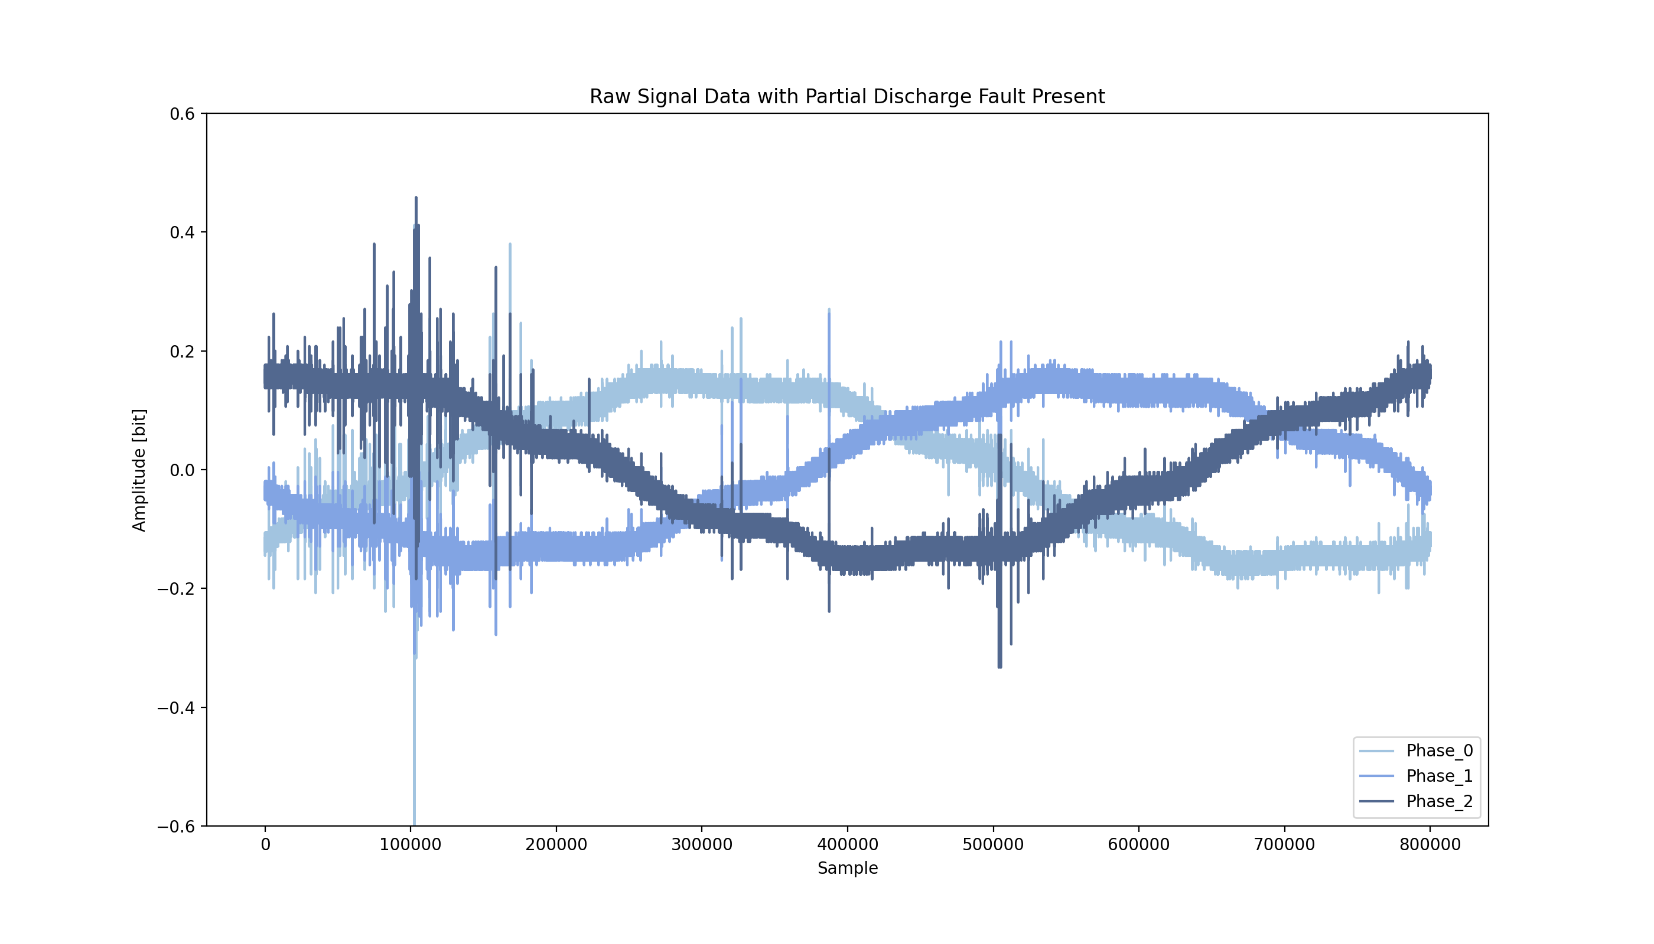
Sample Measurements with 3 Phase Signals
Each signal (phase) contains 800,000 measurements of a power line’s voltage, taken over 20 milliseconds.
For signal processing, that means each signal data set has a sample rate of 40 million samples per second.
The underlying electric grid operates at 50Hz, this means each signal covers a single complete grid cycle.

Slide 5
Quick EDA Reveals Highly Unbalanced Data
All Provided Data: Labeled & Unlabeled
Labeled Training Set: 2,904 Measurements = 8,712 Signals (only 30% of data is labeled)
Unlabeled Test Set: Perform Binary Classification: 6,779 Measurements = 20,337 Signals
Occurrence of Faults and Non-Faults in Labeled Data
8187 Signals without Fault, 213 Signals with Fault (only 2.5% of labeled signals have faults!)
Grouping of Signal Faults per Measurement
Measurements with no faults present: 2710 (93.3% of measurements exhibit no fault)
Measurements with fault present in only 1 phase: 19 (9.7% of cases where faults present)
Measurements with faults present in 2 of 3 phases: 19 (9.7% of cases where faults present)
Measurements with faults present in all 3 phases: 156 (80.4% of cases where faults present)

Slide 6
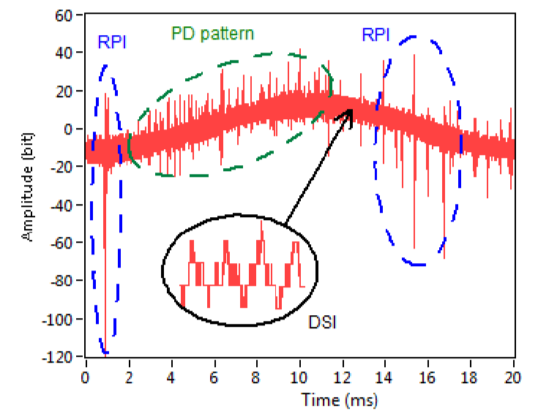
Detecting Partial Discharges is Difficult
PD Pattern Observed alongside other Noise Sources
Many other sources of noise could be falsely attributed to partial discharge.
Ambient and Amplifier Noise
PD: Partial Discharge Fault Pattern
DSI: Discrete Spectral Interference
E.g. Radio Emissions, Power Electronics
RPI: Random Pulses Interference
Lightning, Switching Operations, Corona
Figure from Reference [1]

Slide 7
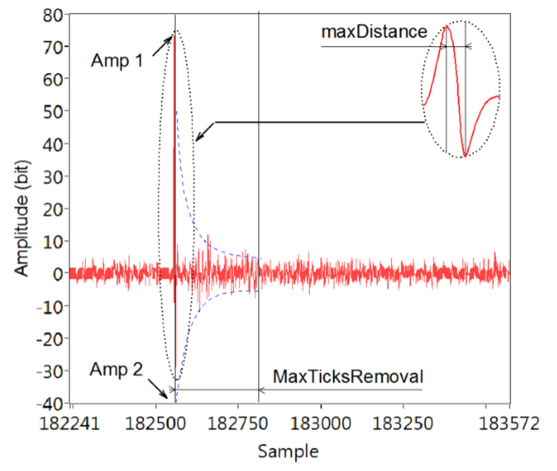

Identifying and Canceling Corona Discharge Peaks
Corona Discharge Pulse Followed by Dumped Oscillation
Spontaneous corona discharges occur naturally in high-voltage systems unless care is taken to limit the electric field strength.
A corona will occur when the strength of the electric field (potential gradient) around a conductor is high enough to form a conductive region, but not high enough to cause electrical breakdown or arcing to nearby objects.
A corona discharge is an electrical discharge brought on by the ionization of a fluid such as air surrounding a conductor that is electrically charged.
Figure from Reference [1]
Identify and flag probable Corona discharge peaks to mitigate false positives

Slide 8
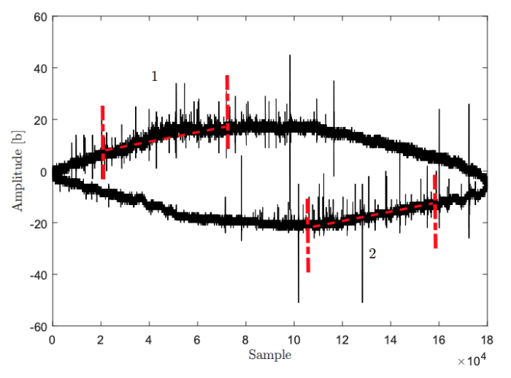
Focus on Portions of the Sinusoid with Rising Amplitude for Improved PD Detection
Sections of Sinusoidal Shape (1,2) with the Statistically Highest Occurrence of PD pulses
One of the most common fundamental features of the PD pattern is that it occurs on the rising amplitude edges of the sinusoidal curve.
During feature extraction, this allows omission of half of the signal data points – increasing processing efficiency.
Running feature extraction on the high-probable region also increases the model’s ability to detect true faults and avoid false positives.
Figure from Reference [2]

Slide 9
Data Preparation & Signal Processing
Three signals per measurement, 800k samples / signal. Signals individually labeled.
Raw Signal
Fit Sinusoid
Probable Region
De-Trend
Trimming
Feature Extraction
Denoising
Notes:
Discrete Wavelet Transform to Remove Spectral Interference and Ambient Noise
Daubechies 4 Wavelet (db4)
Fit a Sinusoidal Function to the DWT Signal and Detect the PD-Probable Region
Use an Nth Discrete Difference to De-Trend the Function
First-order has proven sufficient
Perform Peak Detection and Subsequently Cancel of False Peaks
Peak Detection using Fixed Amplitude Threshold
Cancel High Amplitude Peaks, and Peaks Attributed to Corona Discharge

Slide 10
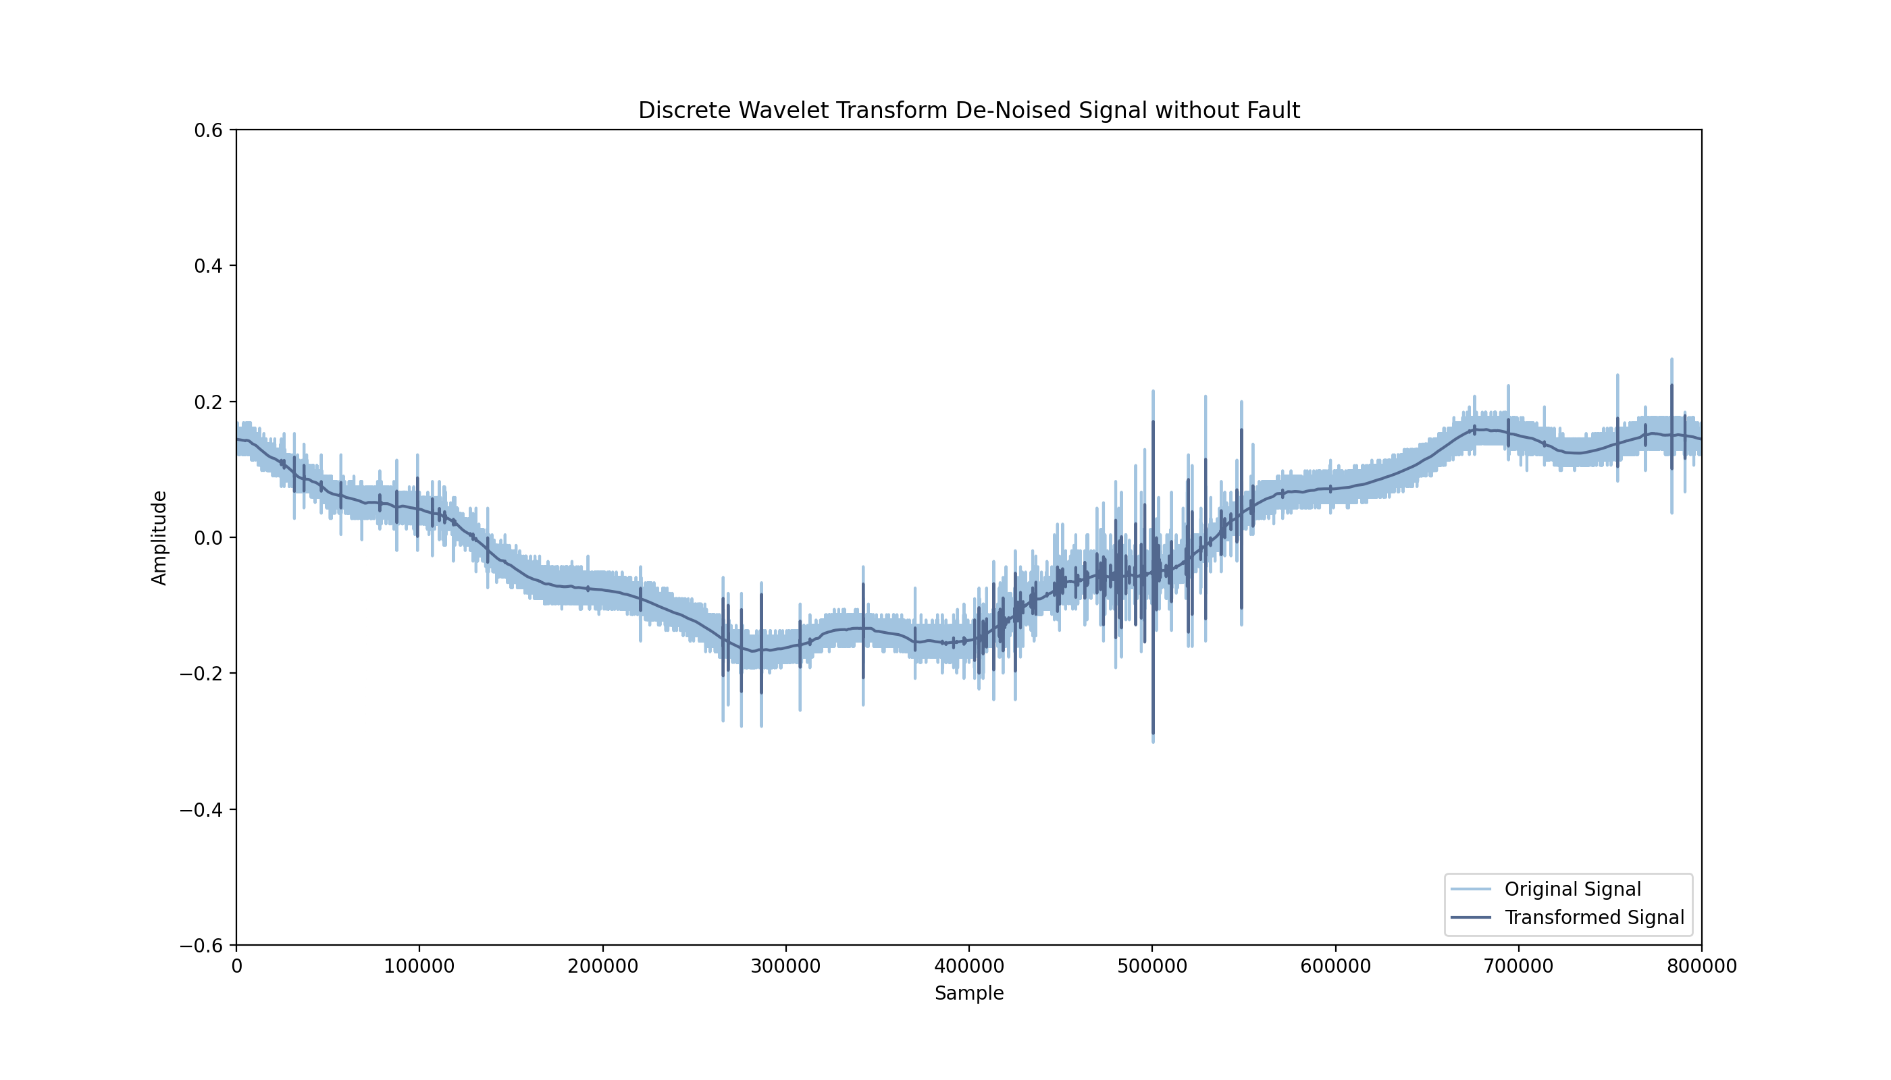
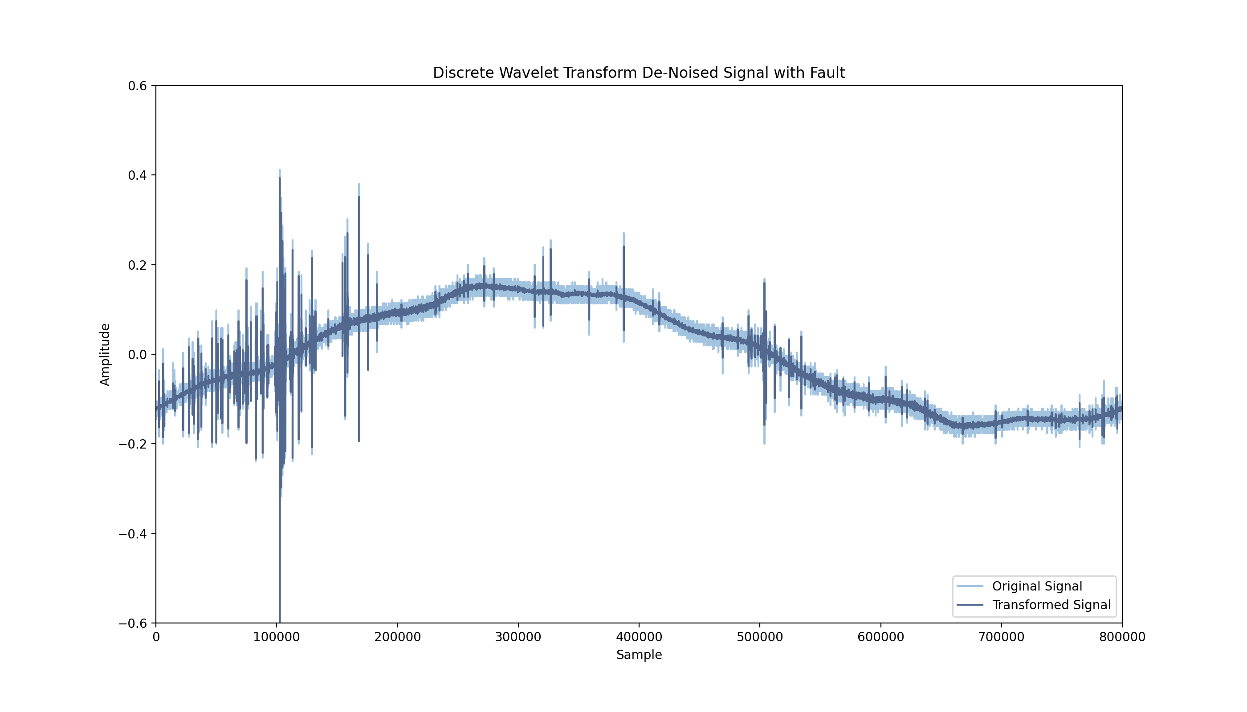
Denoising – Remove DSI & Ambient Noise with DWT
Discrete Wavelet Transform to Remove Spectral Interference and Ambient Noise – Daubechies 4 Wavelet (db4)
Raw Signal
Fit Sinusoid
Probable Region
De-Trend
Trimming
Feature Extraction
Denoising

Slide 11
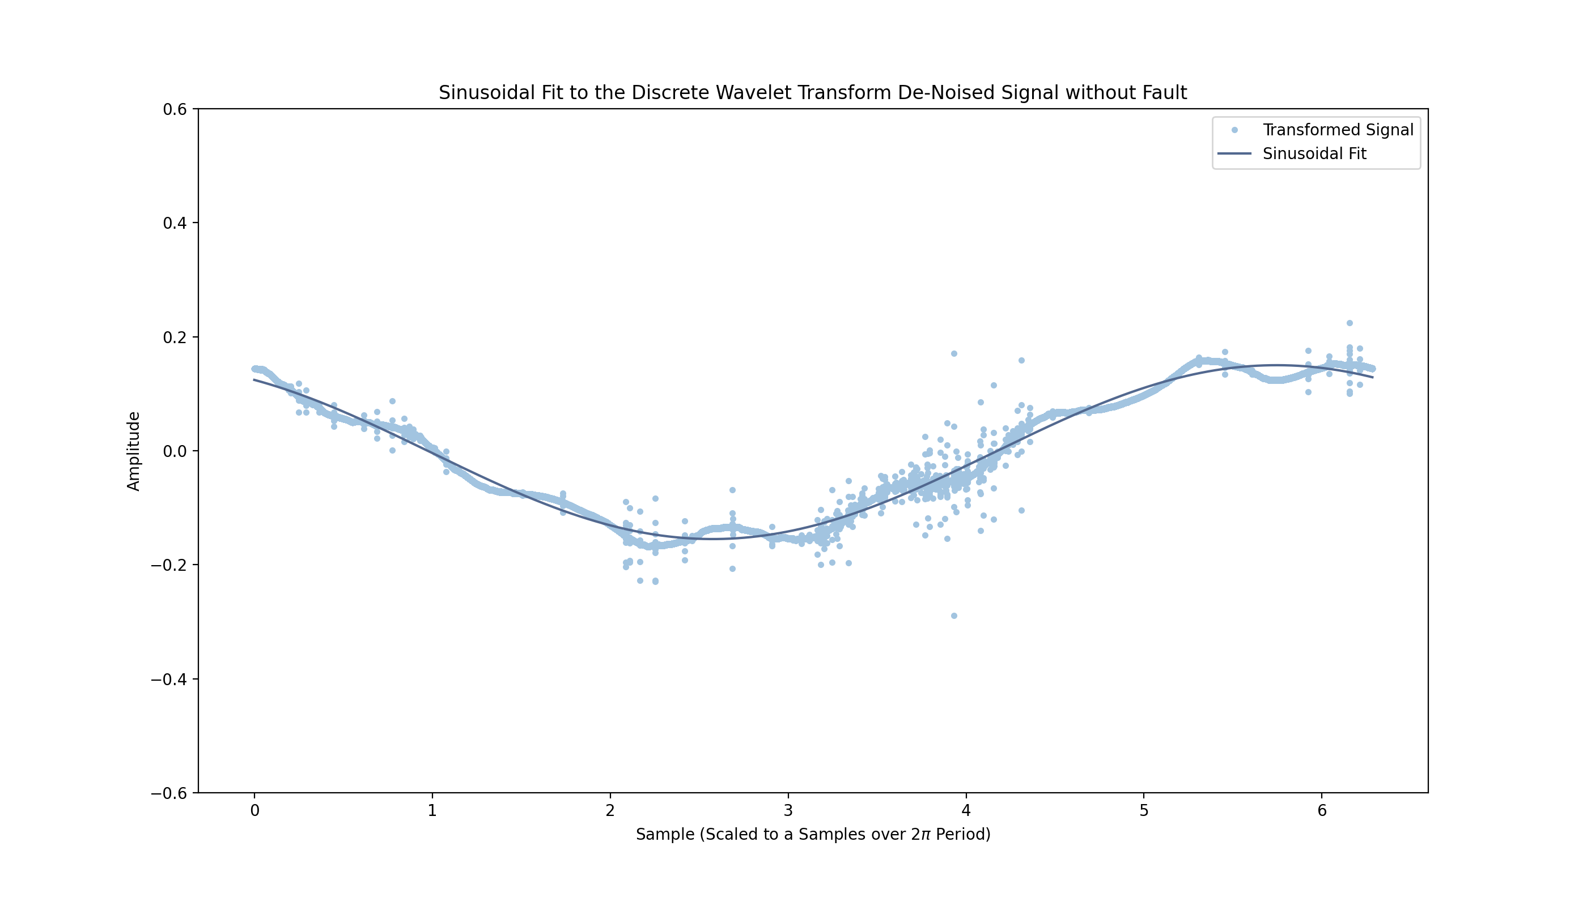
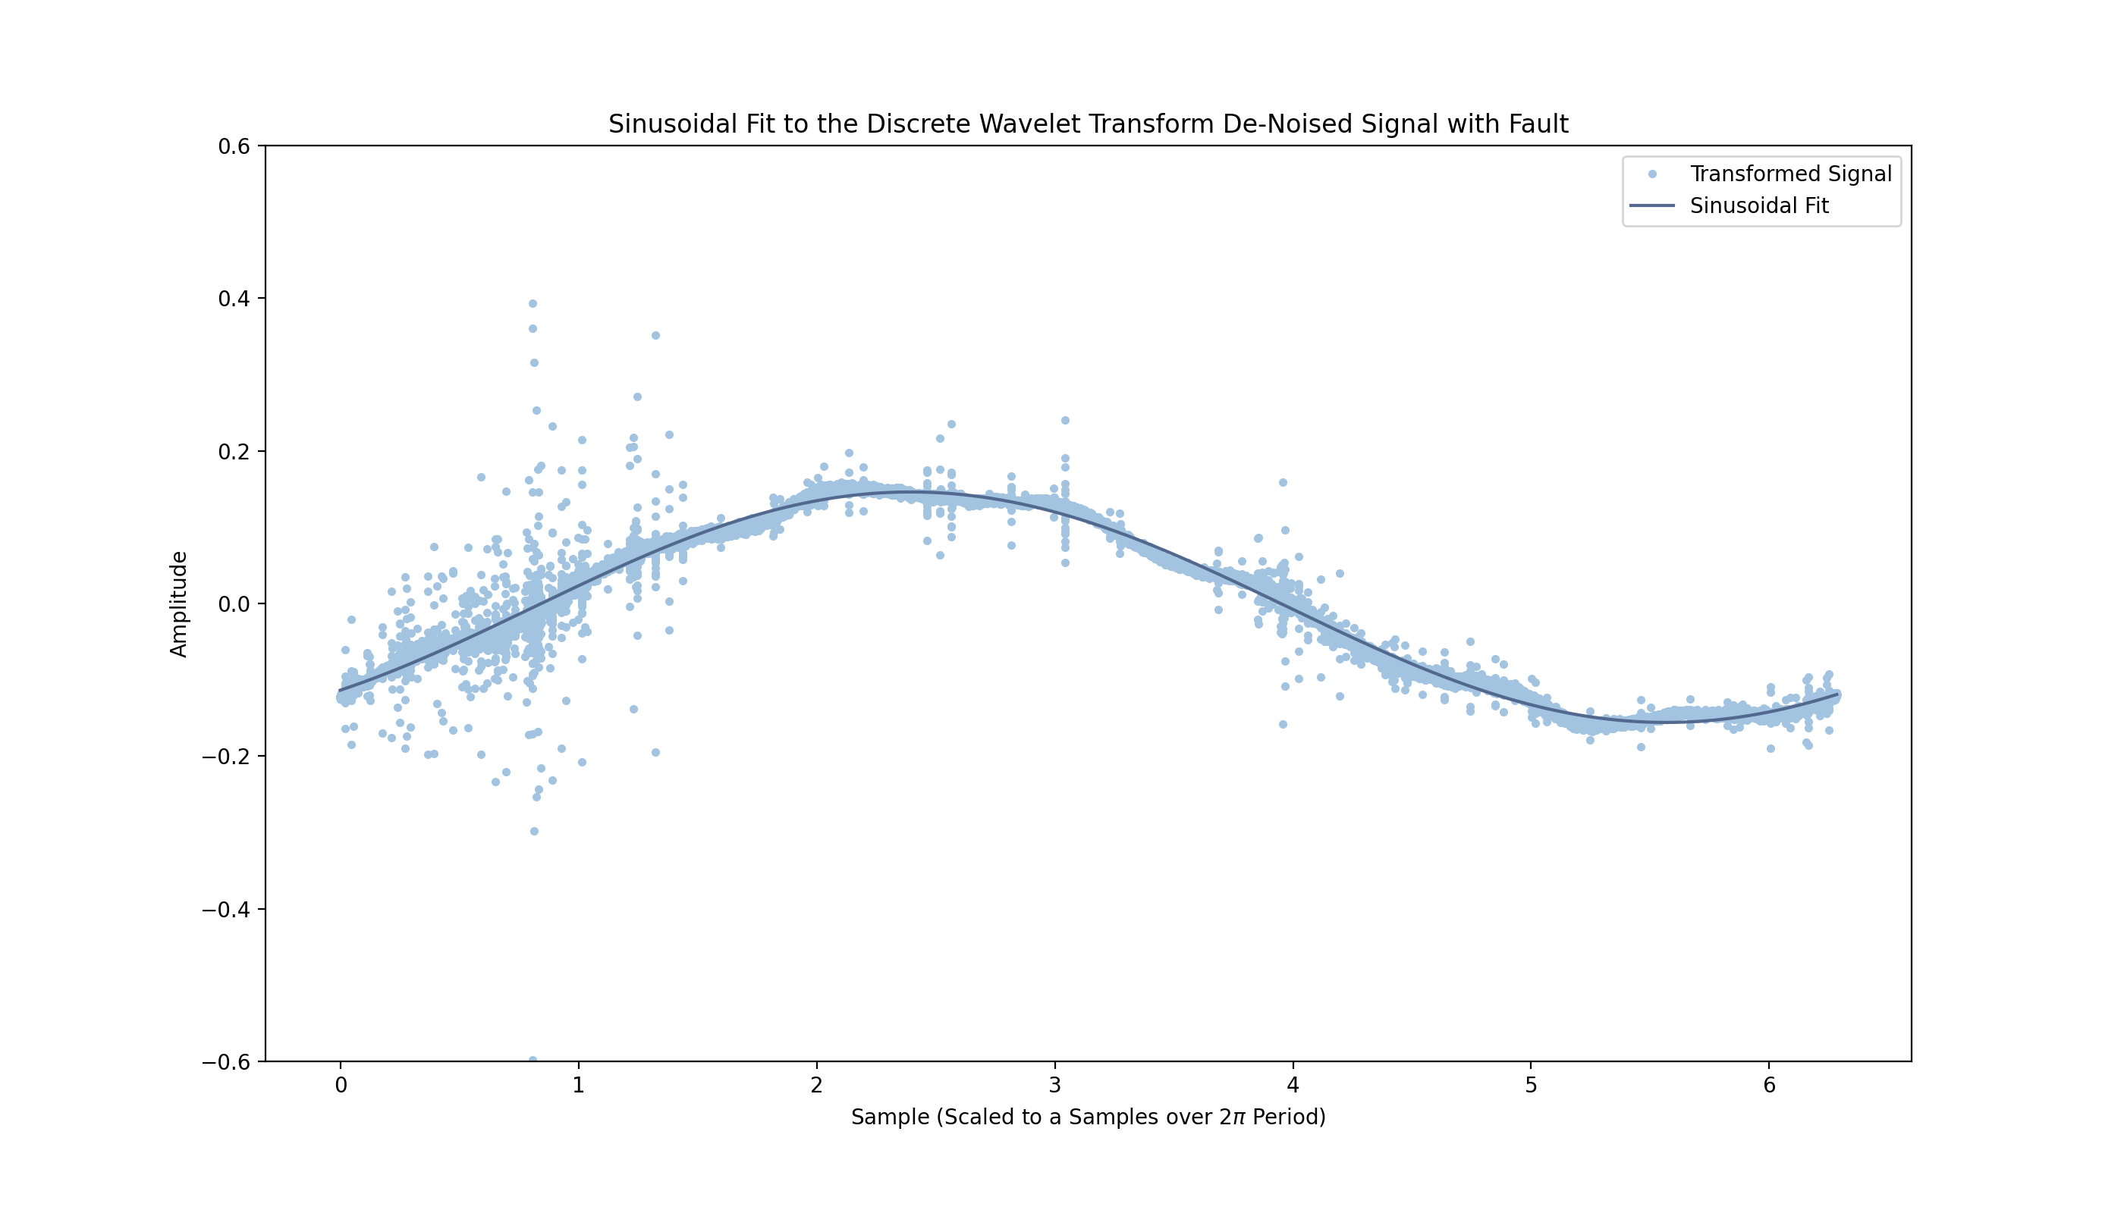
Fit a Sinusoidal Function to the DWT Signal
Fit a 50Hz sinusoid to the de-noised signal with a least squares approach
Raw Signal
Fit Sinusoid
Probable Region
De-Trend
Trimming
Feature Extraction
Denoising
Notes:
Generate your own 50Hz sinusoid, least_squares optimizer

Slide 12
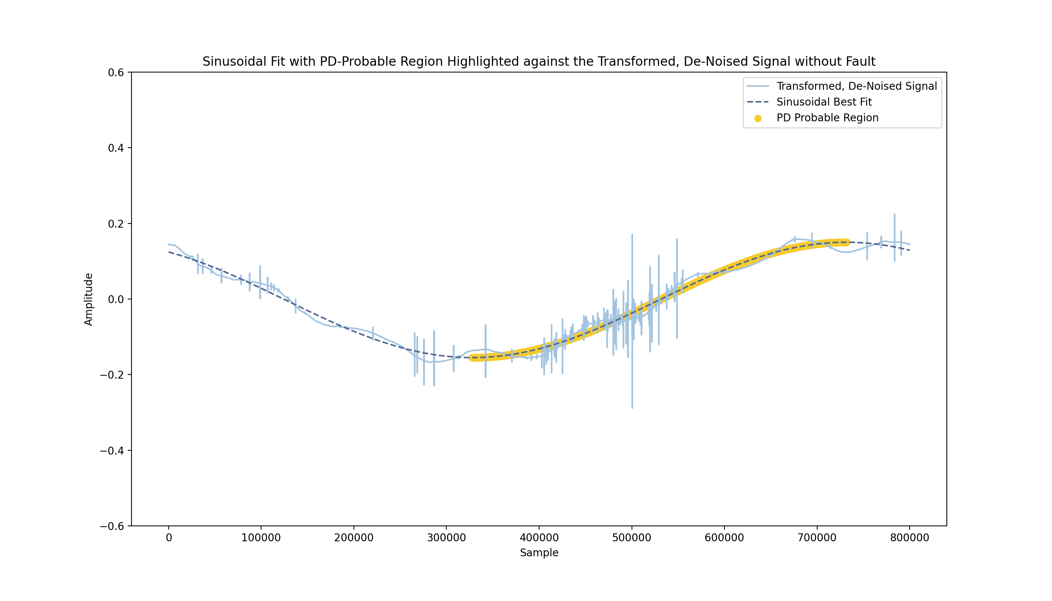
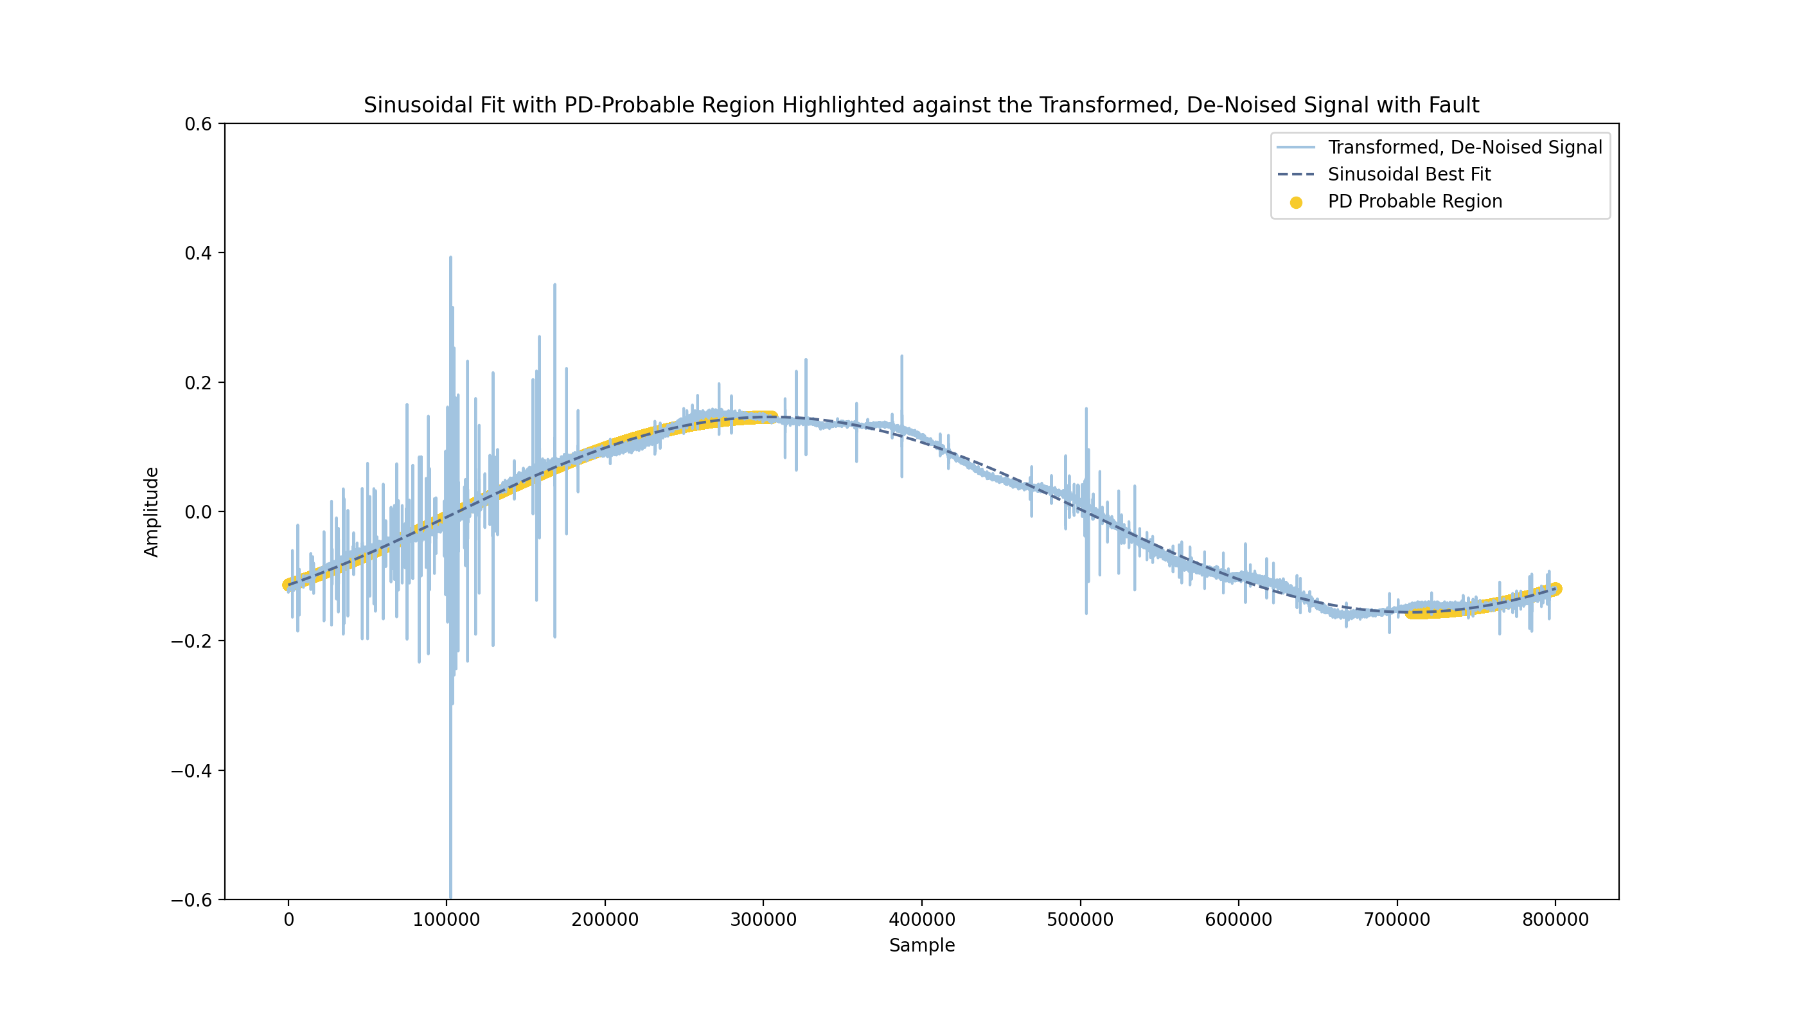
Use Rising Amplitude to Identify the PD-Probable Region
Use first derivative to index the rising amplitude of the sinusoid and highlight the PD-probable region of the signal
Raw Signal
Fit Sinusoid
Probable Region
De-Trend
Trimming
Feature Extraction
Denoising
Notes:
Used np.gradient for first derivative

Slide 13
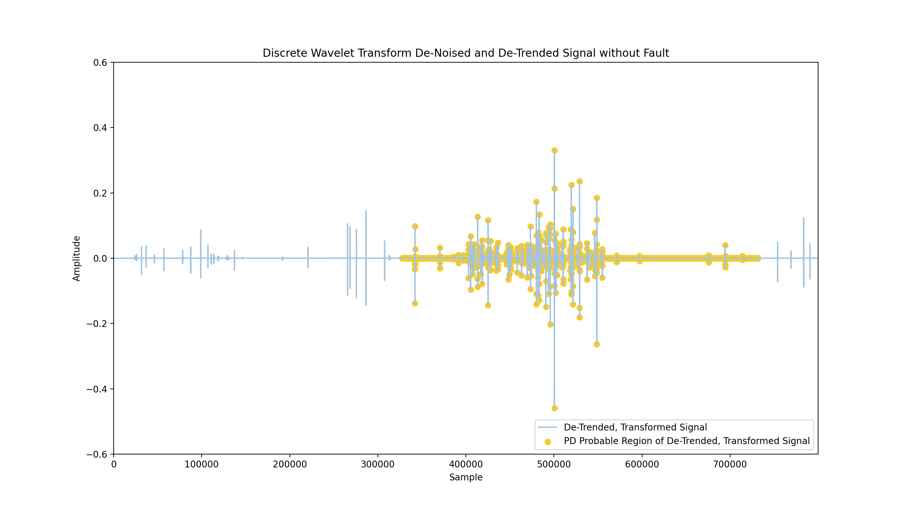
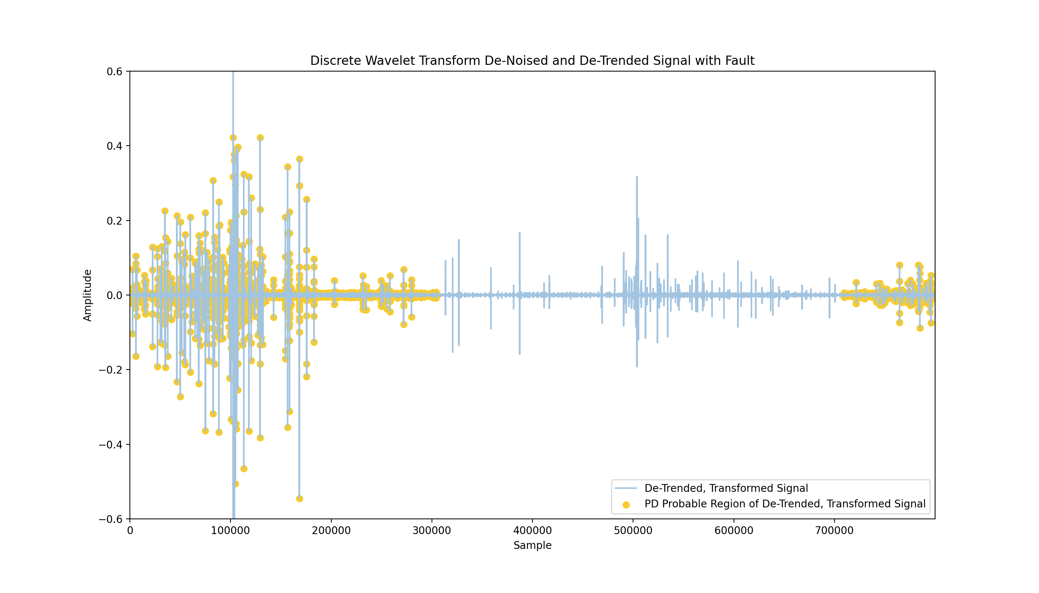
Detrend Signal to Remove Sinusoidal Element
Use an Nth Discrete Difference to De-Trend the Function – First Order was Sufficient
Raw Signal
Fit Sinusoid
Probable Region
De-Trend
Trimming
Feature Extraction
Denoising
Notes:
Avoids discontinuity from phase-wrap
Gives more significance to statistics like mean and variance
Calculate mean crossing and zero crossing
x = np.diff(signal, n=1, axis=-1) # Calculate the n-th discrete difference along the given axis

Slide 14
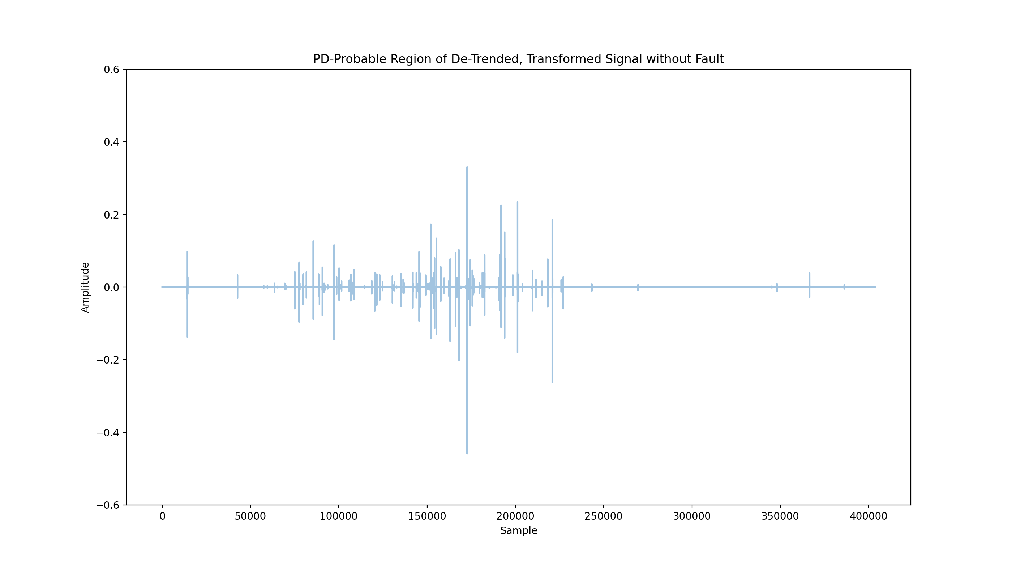
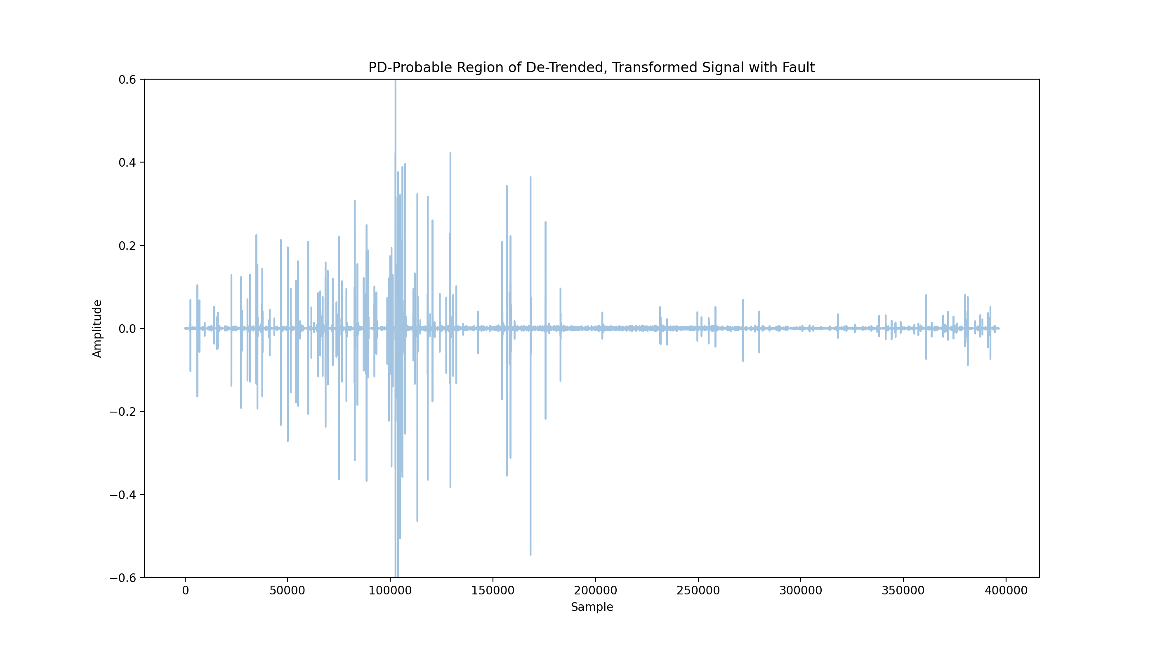
Trim Signal to Only Look at the PD-Probable Region
Discard the non-probable region, and trim the signal from 800k to 400k samples
Raw Signal
Fit Sinusoid
Probable Region
De-Trend
Trimming
Feature Extraction
Denoising

Slide 15
Perform Feature Extraction on Signal
Process the PD-Probable Region of the De-Trended, De-Noised Signal and Build a Feature Matrix to be used as Input to Machine Learning and Deep Learning Models.
Extraction Yields 36 Features
Mean
Standard Deviation
Variance
Mean + Std. Deviation
Mean - Std. Deviation
Max Range
Root Mean Square
Entropy
Number Crossings (mean & zero)
Percentiles [0, 1, 25, 50, 75, 99, 100]
Relative Percentiles (pctl. - mean)
Peak Counts (True, Cancelled)
Peak Statistics (mean/max height, width, etc)
Slice the signal into 400 parts (each 1000 samples in length)
Calculate and determine features per slice
Final Feature Array Shape: [8275, 36, 400]

Slide 16
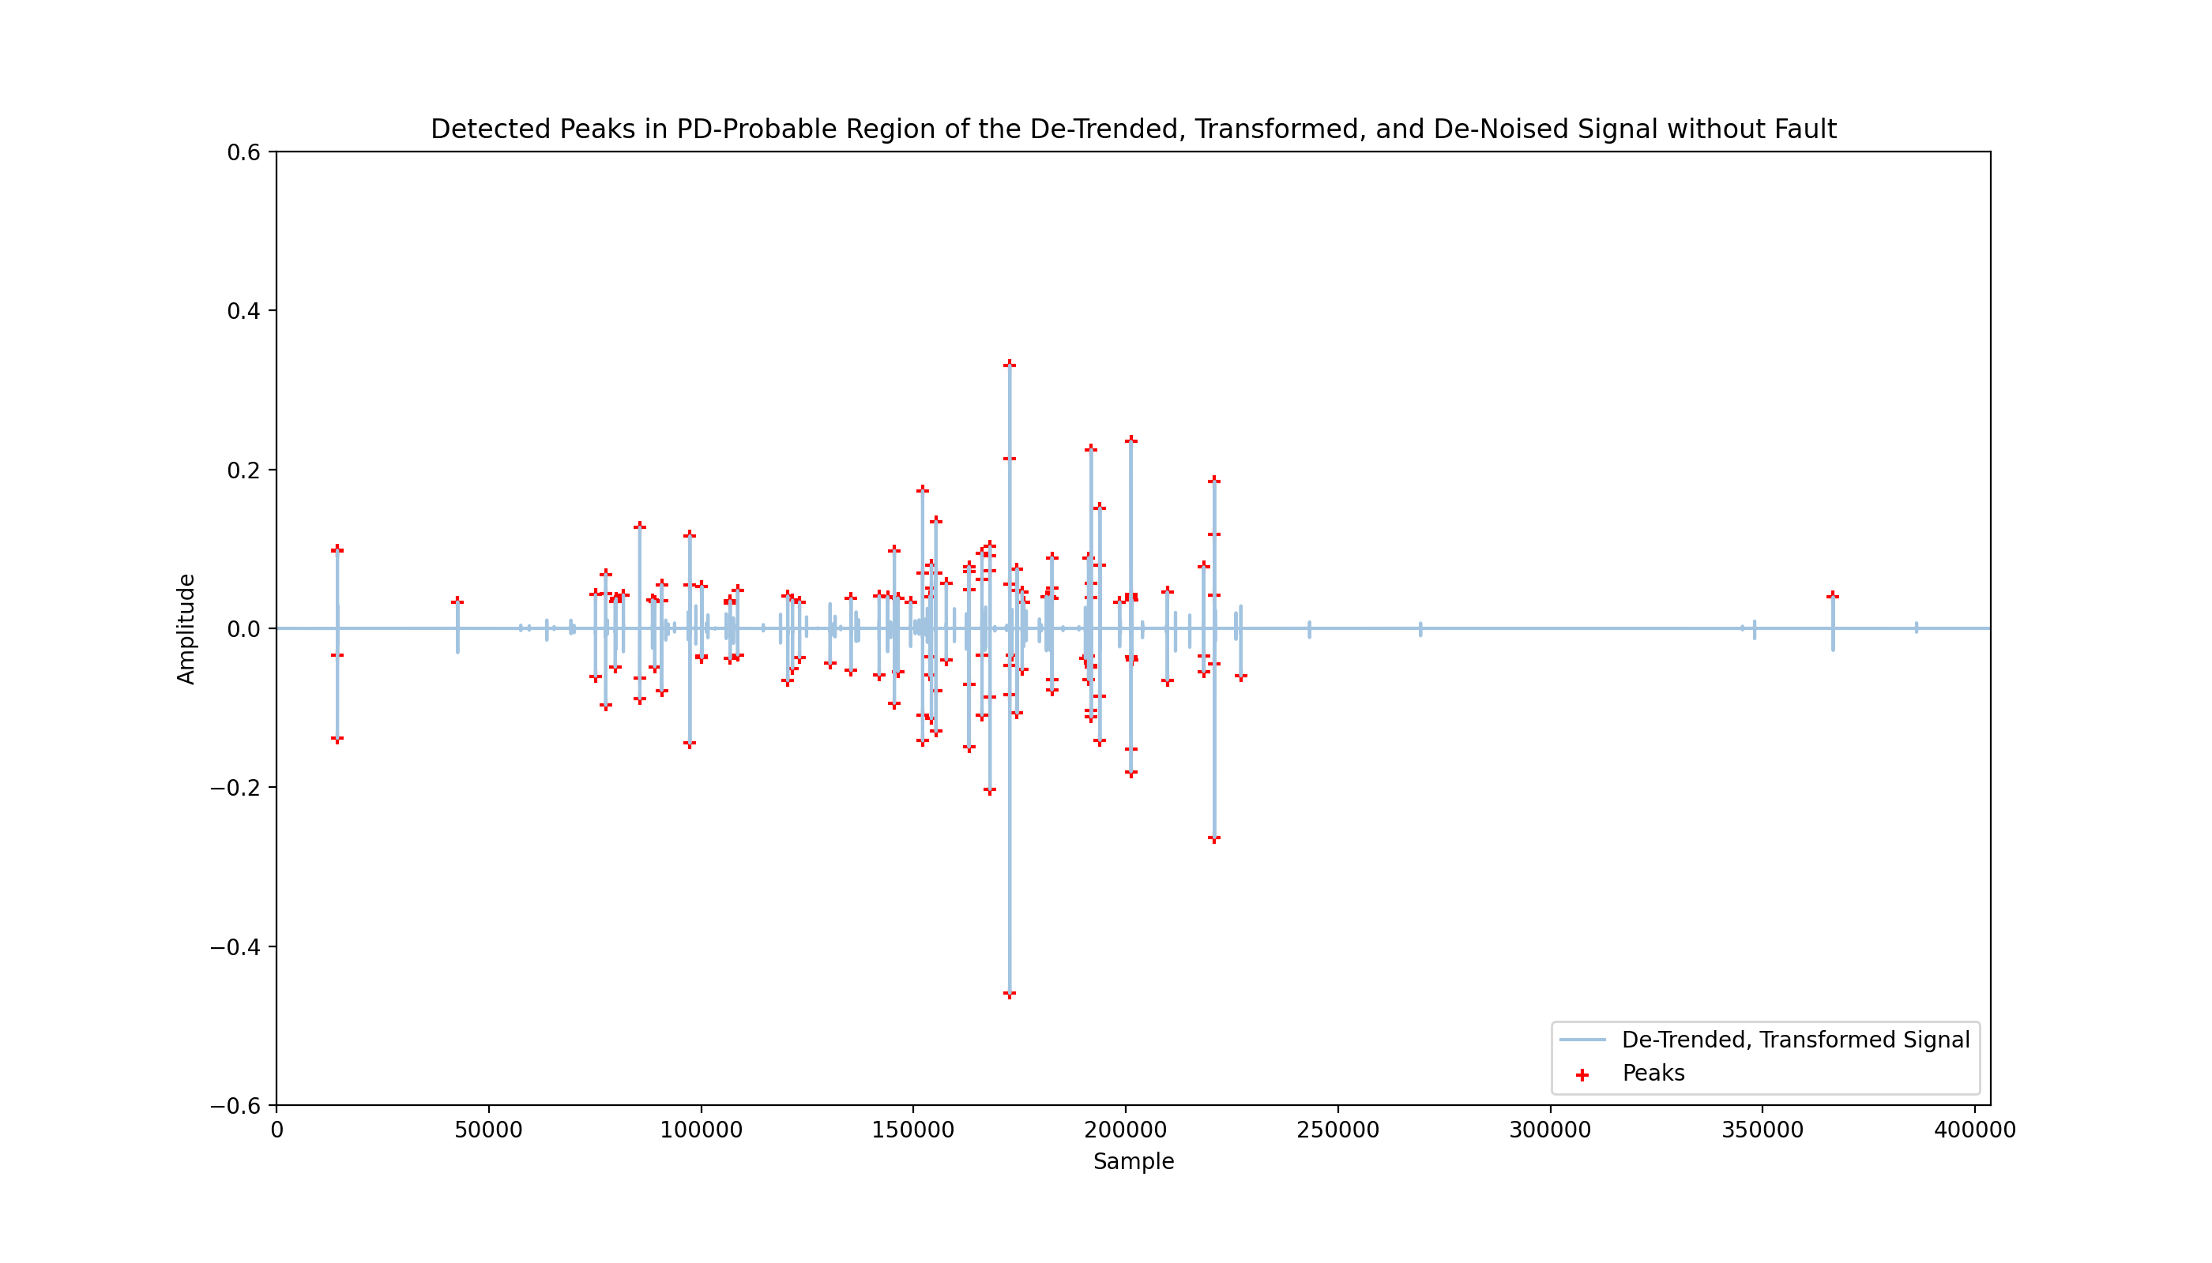
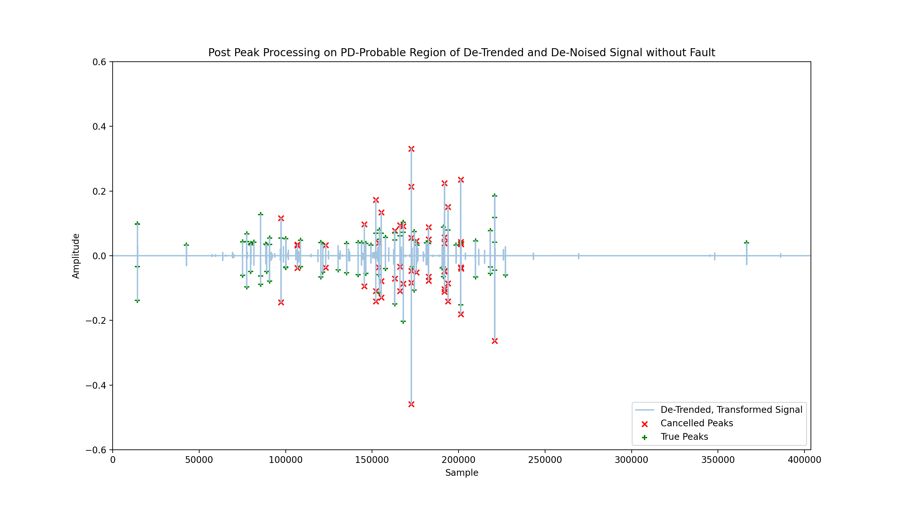
False Peaks Cancellation
From reviewing background literature on the subject, it was made clear that a statistically significant portion of the false positives in prior research were driven by false peaks.
False peaks…
Reach much higher amplitude than the PD-pattern
Were often followed by another large peak of opposite polarity, creating a nearly symmetric pair
Have an identifiable “pulse trains” in the time domain.
Signal without Fault, Before and After False Peak Cancellation
Figure from Reference [1]

Slide 17
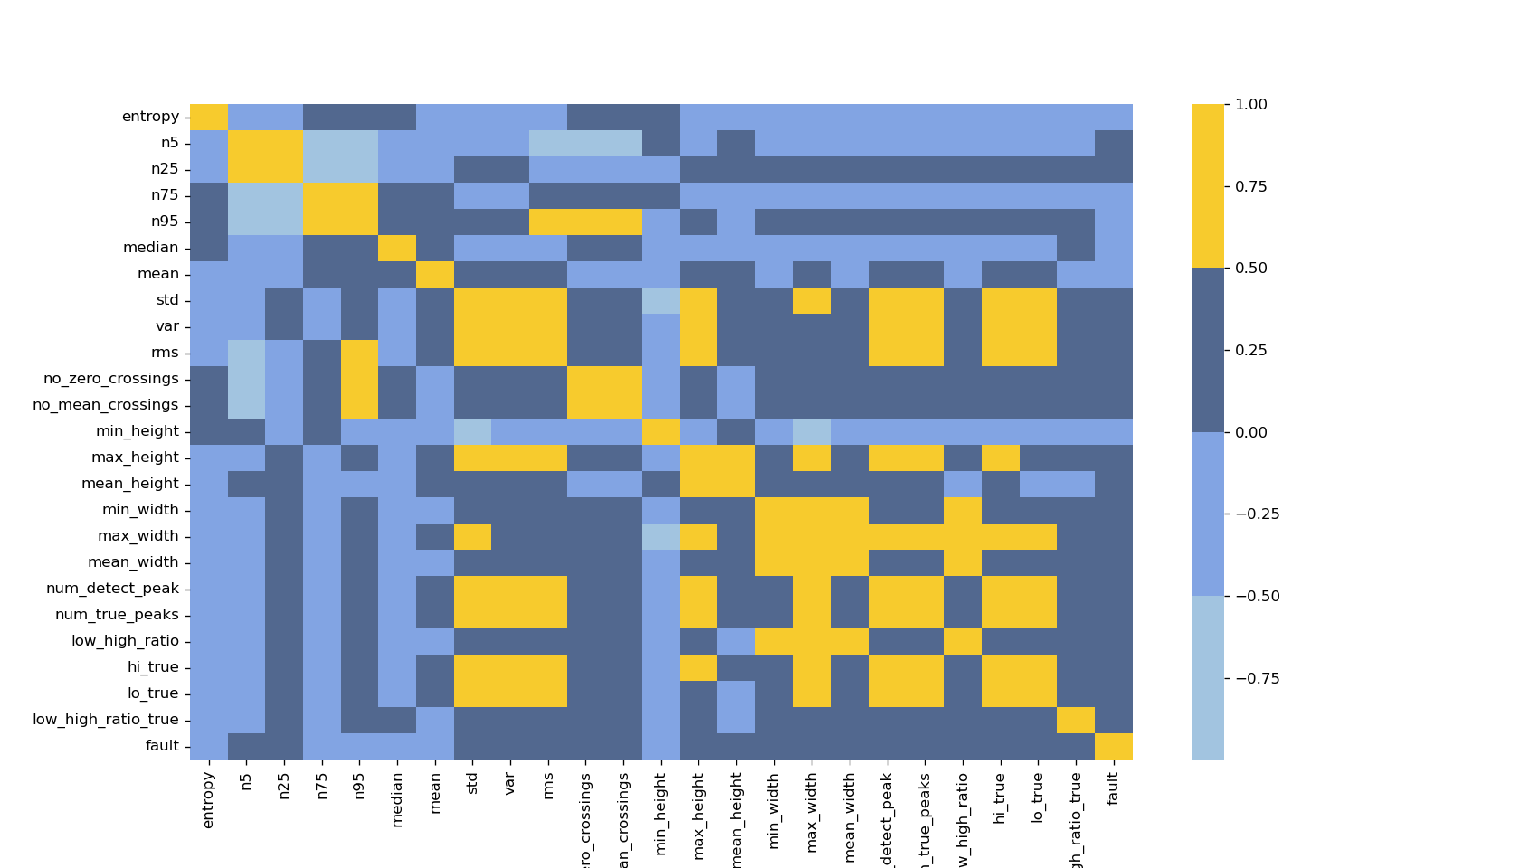
Feature Exploration – Correlation Heat Map
Useful for a quick sanity check on extracted features. Opportunity to discover features highly correlated with fault.

Slide 18
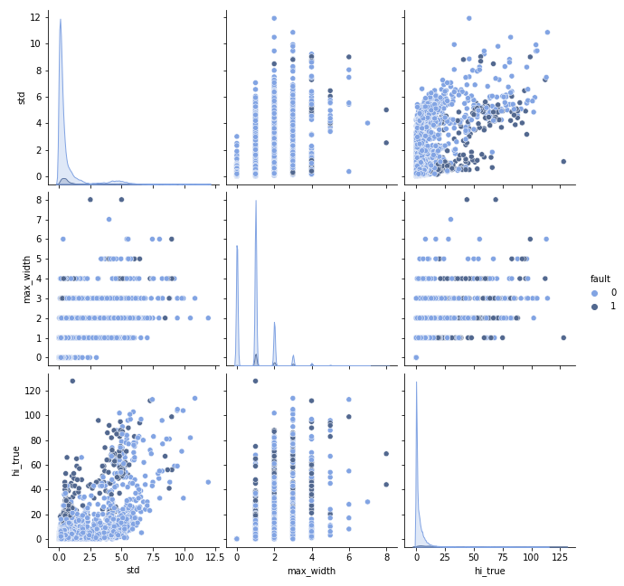
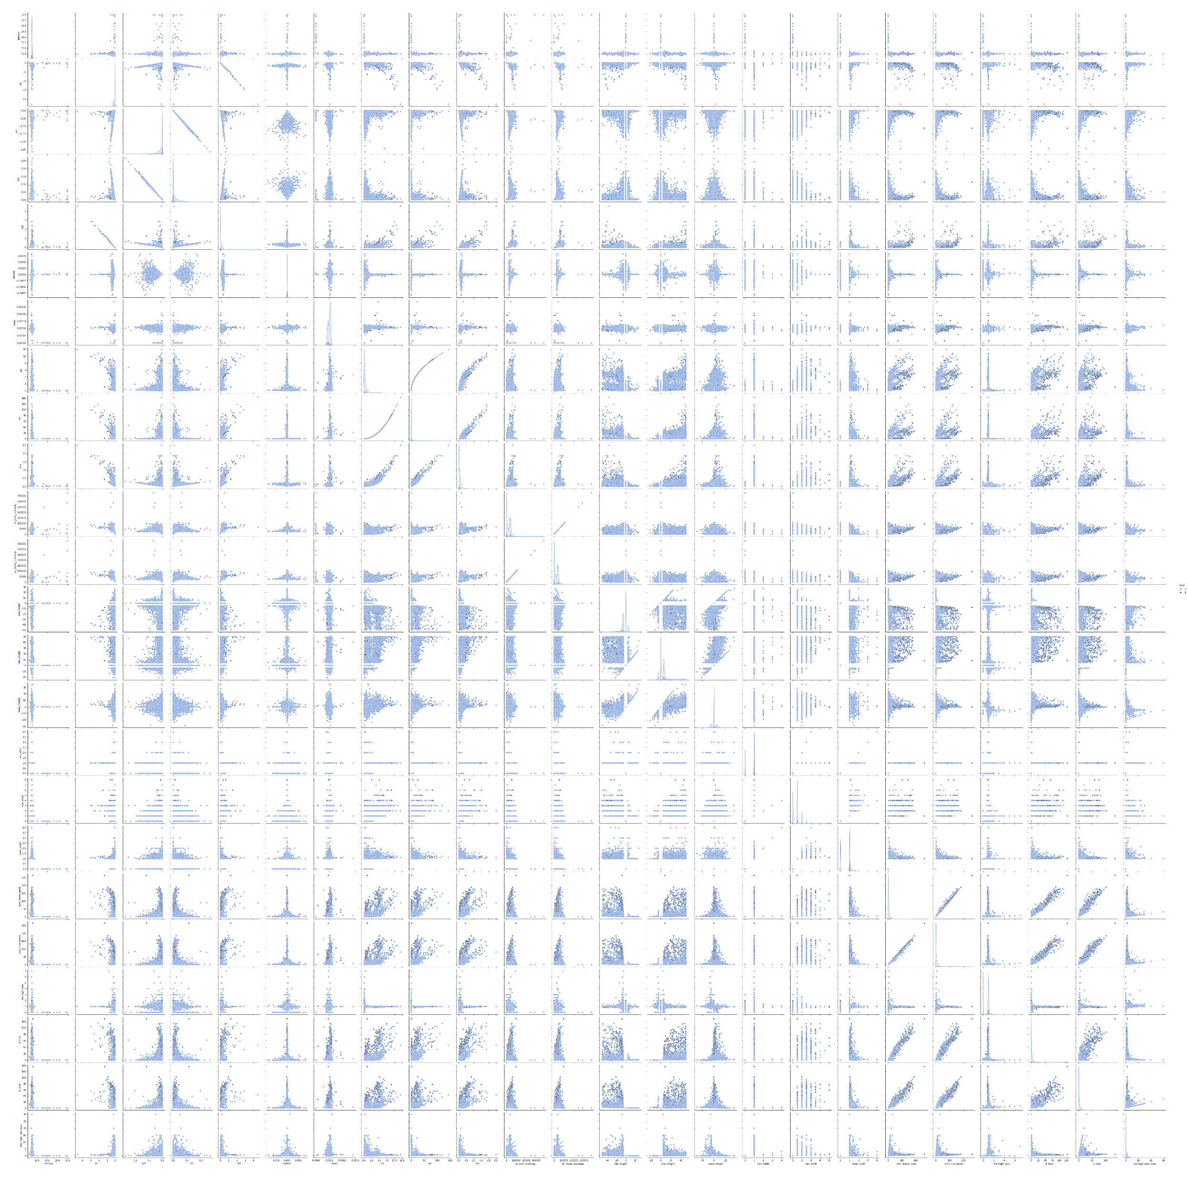
Feature Exploration – Pair Grids & PDF Estimates
3x3 Pair Grid to Show Detail
Scatters and KDE (probability density estimations)
Full Pair Grid
Opportunity to perform a Principal Component Analysis to reduce dimensionality of the feature array
Notes:
In statistics, kernel density estimation (KDE) is the application of kernel smoothing for probability density estimation

Slide 19
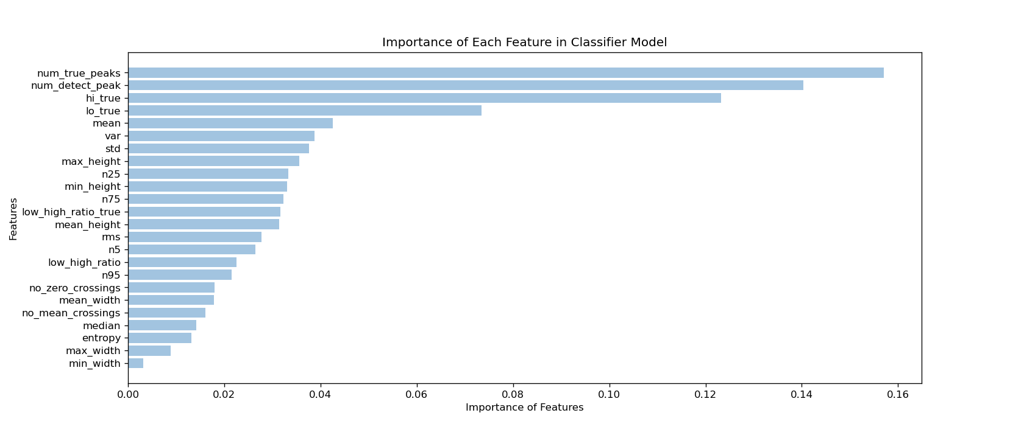
Not All Features are Equally Influential
Later in the process, some features with minimal influence may be omitted to reduce the size of a model

Slide 20
Machine Learning Approaches
k-Nearest Neighbors (k-NN)
Monte Carlo over k parameter
Support Vector Machines (SVM)
Radial Basis Function (rbf) kernel and Monte Carlo over gamma parameter.
Random Forest Decision Trees (RF)
Regarded for handling unbalanced data when tuned properly.
Light Gradient Boosting Framework
Powerful, tree-based learning algorithm that grows vertically (leaf-wise)
Sensitive to overfitting on small data sets (<10,000 data points)
In binary classification, model returns probability that a sample belongs to the positive class.

Slide 21
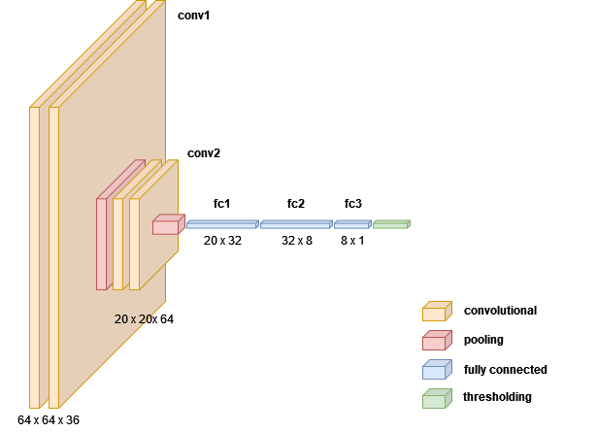
Deep Learning Approaches
Recurrent Neural Network (LSTM)
Signal length (400k) too excessive to feed directly without further processing (e.g. truncating, compressive sampling, or some encoder-decoder architecture).
They can be adapted for classification but prior experience with LSTM models used for time series prediction
Convolutional Neural Network (CNN)
Effective at pattern recognition and anomaly detection
Simple CNN Model:
Convolution layers (feature extraction)
Pooling layers (decrease the size of convolved feature maps, summarizes features)
Fully connected layers (flattening & classification)
Dropout (mitigates overfitting when all features are fully connected
VSBNet
Notes:
VSBNet(
(conv0a): Conv1d(36, 64, kernel_size=(4,), stride=(1,))
(conv0b): Conv1d(64, 64, kernel_size=(4,), stride=(1,))
(mp0): MaxPool1d(kernel_size=2, stride=2, padding=1, dilation=1, ceil_mode=False)
(conv1a): Conv1d(64, 20, kernel_size=(4,), stride=(1,))
(conv1b): Conv1d(20, 20, kernel_size=(4,), stride=(1,))
(gap1): AvgPool1d(kernel_size=(192,), stride=(192,), padding=(0,))
(do1): Dropout(p=0.2, inplace=False)
(fc0): Linear(in_features=20, out_features=32, bias=True)
(do2): Dropout(p=0.3, inplace=False)
(fc1): Linear(in_features=32, out_features=8, bias=True)
(do3): Dropout(p=0.3, inplace=False)
(fc2): Linear(in_features=8, out_features=1, bias=True)
)

Slide 22
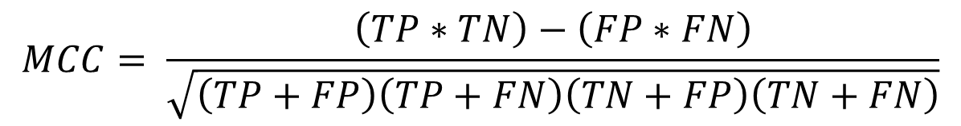
Evaluate Network Performance with MCC
Network performance is evaluated using Matthews Correlation Coefficient (MCC) between the predicted and observed response. The MCC is given by: where TP is the number of true positives, TN the number of true negatives, FP the number of false positives, and FN the number of false negatives.
Matthews Correlation Coefficient is an apt metric to assess a binary classification network, especially one with a highly unbalanced class where metrics like accuracy, precision, and recall don’t adequately capture the effectiveness of a network.
$$MCC= \frac{\left(TP∗TN\right)−\left(FP∗FN\right)}{\sqrt{\left(TP+FP\right)\left(TP+FN\right)\left(TN+FP\right)\left(TN+FN\right)}}$$

Slide 23
Use k-Fold CV to Ensure Model Robustness to Test/Train Splits
Use Ensemble k-Fold Cross-Validation to Validate Model Robustness to Test-Train Splits
Splits the data into k parts, Take k-1 parts as training data and 1 part for validation
Train and predict with the model k times over, holding out a different part each time.
Ensemble output produces probability of sample belonging to a class, not assignment
Average and use the prediction probabilities from the k scores to assign a class
k=1
k=2
k=3
k=4
k=5
Train
Train
Train
Train
Test
An example of 5-fold Cross Validation.
For each iteration, fit the model on the training folds and evaluate it using the test fold.
Retain the evaluation scores and probabilities between iterations but discard the trained model.
Train
Train
Train
Test
Train
Train
Train
Test
Train
Train
Train
Test
Train
Train
Train
Test
Train
Train
Train
Train

Slide 24
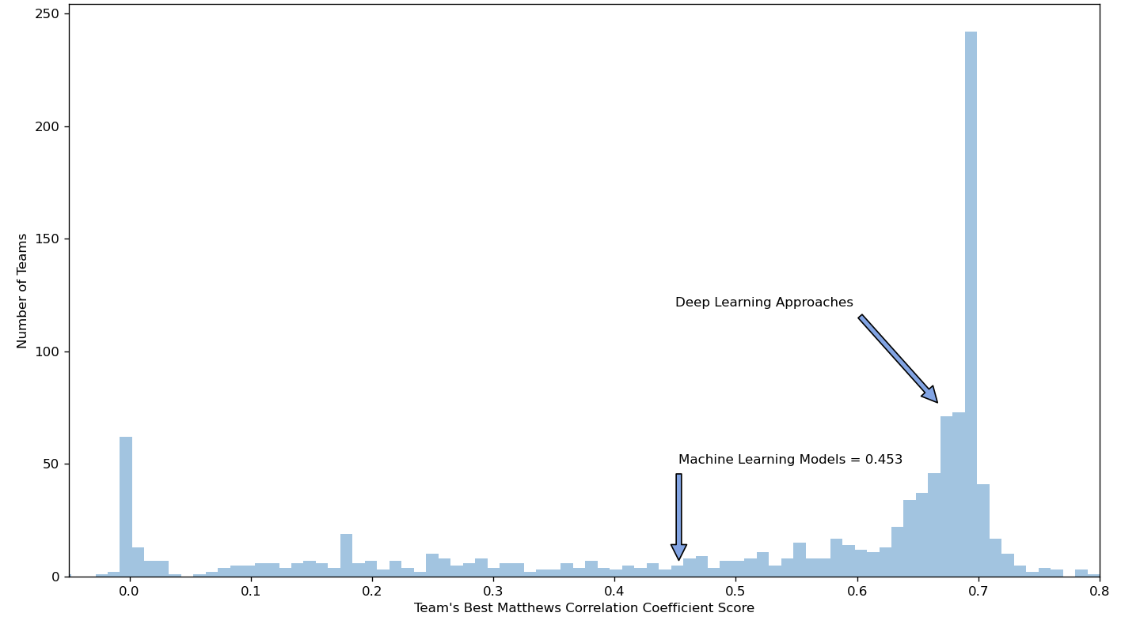
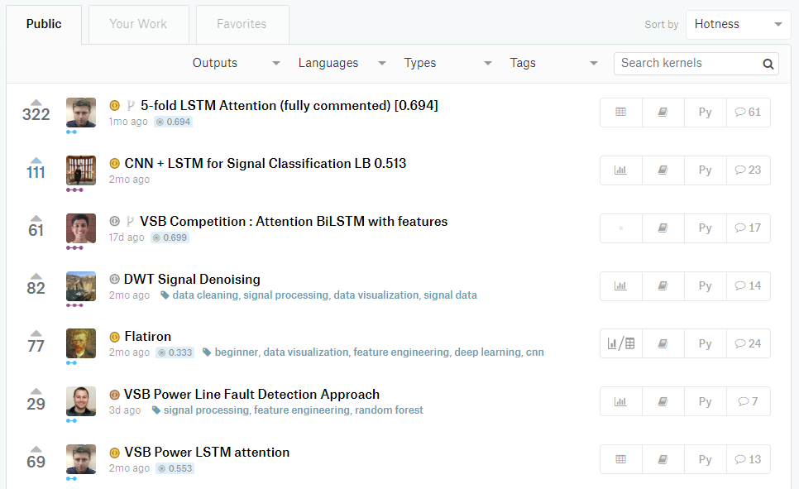
Results – Distribution of Public Leaderboard Scores
Users replicating a successful approach
1083 Total Teams
Deep Learning
MCC = 0.705 local test set
Machine Learning
MCC = 0.517 local test set
MCC = 0.453 on withheld set
Top Scores
0.800
0.788
0.786
Notes:
1083 teams
c_train = confusion(y_pred_train > 0, data.y_train)
true_positives, false_positives, true_negatives, false_negatives
print(c_train) # (212, 118, 7658, 287)
print(mcc(*c_train)) # 0.49838358624446083
c_val = confusion(y_pred_val > 0, data.y_val)
true_positives, false_positives, true_negatives, false_negatives
print(c_val) # (16, 3, 407, 10)
print(mcc(*c_val)) # 0.7053190215817398

Slide 25
Interesting Observations and Lessons
Use the right performance metric
Traditional metrics like accuracy, precision, recall, and F1 scores can be misleading
Matthews Correlation Coefficient – an effective binary classification performance measure - even for classes of very different sizes.
Pearson’s Chi-Squared Test - a similar metric for higher order classification problems
Account for the influence of test-train splits
With so few samples belonging to one of the classes, results can vary wildly
Rerun analyses while varying splits and random states to find robust performance predictions.
StratifiedShuffleSplit helps here, returning stratified randomized folds that preserve the percentage of records for each class.
Use a model or framework built for the task, and tune it properly
Some models are more adept at handling unbalanced classes than others
Modify and iterate on the impact of class weights, don’t rely on defaults
Ensemble Cross-Validation – robust test-train splits, produces probabilities not classes
Use Probabilities of Class Assignment to Under or Over Predict a Class

Slide 26
Possible Paths to Improve this Project
Move from Detection in Single Cycles to an Accumulator or N-Cycle Detection
Detect persistent faults while mitigating sporadic effects like corona
Data should already exist: signal data is device or location tagged
Perform Classification at the Measurement level instead of Signal Level
While not globally true, when a fault is present in one phase, the likelihood of fault present in one or both or the other phases is high – 90.3%.
Potentially trades a significant reduction in available training data points for improved classification
Data augmentation
Using discarded sections as additional null target data – further imbalances class distribution
A second pass with different slicing and windowing
Take signals with known faults, use them to synthesize new signals
Revisit Recurrent Neural Networks – LSTM
Take pre-processed signal, and window around the region dense with peaks to further trim signal length
Investigate the use of a compressive sampler to further reduce the time series if needed
Notes:
Measurements with no faults present: 2710 (93.3% of measurements exhibit no fault)
Measurements with fault present in only 1 phase: 19 (9.7% of cases where faults present)
Measurements with faults present in 2 of 3 phases: 19 (9.7% of cases where faults present)
Measurements with faults present in all 3 phases: 156 (80.4% of cases where faults present)
True positives for PD … 8187 Signals without Fault, 213 true positives

Slide 27
References
Misak, S., et al. “A Complex Classification Approach of Partial Discharges from Covered Conductors in Real Environment.” IEEE Transactions on Dielectrics and Electrical Insulation, vol. 24, no. 2, 2017, pp. 1097–1104., doi:10.1109/tdei.2017.006135.
Vantuch, Tomas. Analysis of Time Series Data, 2018, dspace.vsb.cz/bitstream/handle/10084/133114/VAN431_FEI_P1807_1801V001_2018.pdf.
My Kaggle kernel and GitHub repos have been set public:
Kaggle Kernel: https://www.kaggle.com/jeffreyegan/vsb-power-line-fault-detection-approach
GitHub: https://github.com/jeffreyegan/VSB_Power_Line_Fault_Detection

Slide 28
Thank you!

Slide 29
Modify Class Weights used in Model Training to Remove Bias
Set and Tune Class Weights
Enables cost-sensitive learning to remove a bias favoring the dominant class
Impose a costly penalty on minority class misclassification
Initially set weights based on ratios of data points in each class
Iterations on tailoring the weights can improve model performance
Example from this Project
Default Weights are Uniform:
class_weight = dict({0:1.0, 1:1.0}) # default weights
Initial set the weights based on ratio of samples in training data.
Recall 213 / 8712 signals have faults present thus set fault weight 8499/2134 = 39.90
class_weight = dict({0:1.0, 1:39.9}) # initial, adjusted weights
Iterate and optimize weights through Monte Carlo analysis
class_weight = dict({0:0.5, 1:2.0}) # optimized, adjusted weights

Slide 30
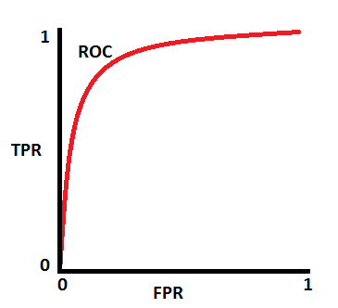
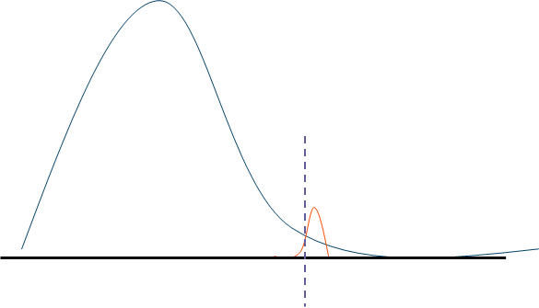
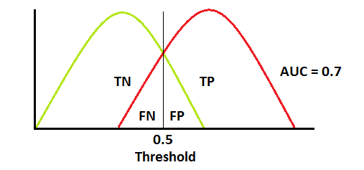
Adjust Thresholds Used for Class Prediction
Adjust Thresholds on Classification Probabilities to Over/Under Predict a Class
Another method to improve minority class performance
Default threshold is 0.5 for binary classification,
Use sklearn.metrics.roc_curve to find and set more appropriate thresholds
fpr, tpr, thresholds = metrics.roc_curve(y, y_prob, pos_label=1)
In the final Partial Discharge detection model, the threshold is set to 0.85
Example ROC & Threshold with Balanced Classes
Setting Threshold for Imbalanced Class
Threshold = 0.85
Notes:
Still Exaggerated but Curves More Representative of PD Data

Slide 31
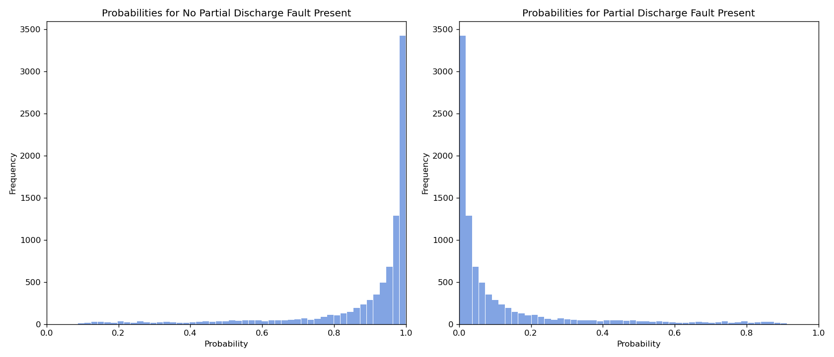
No Fault / Fault Probabilities

Slide 32
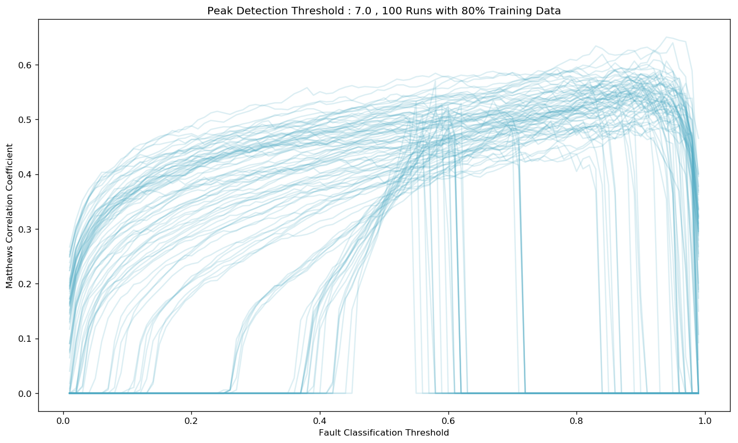
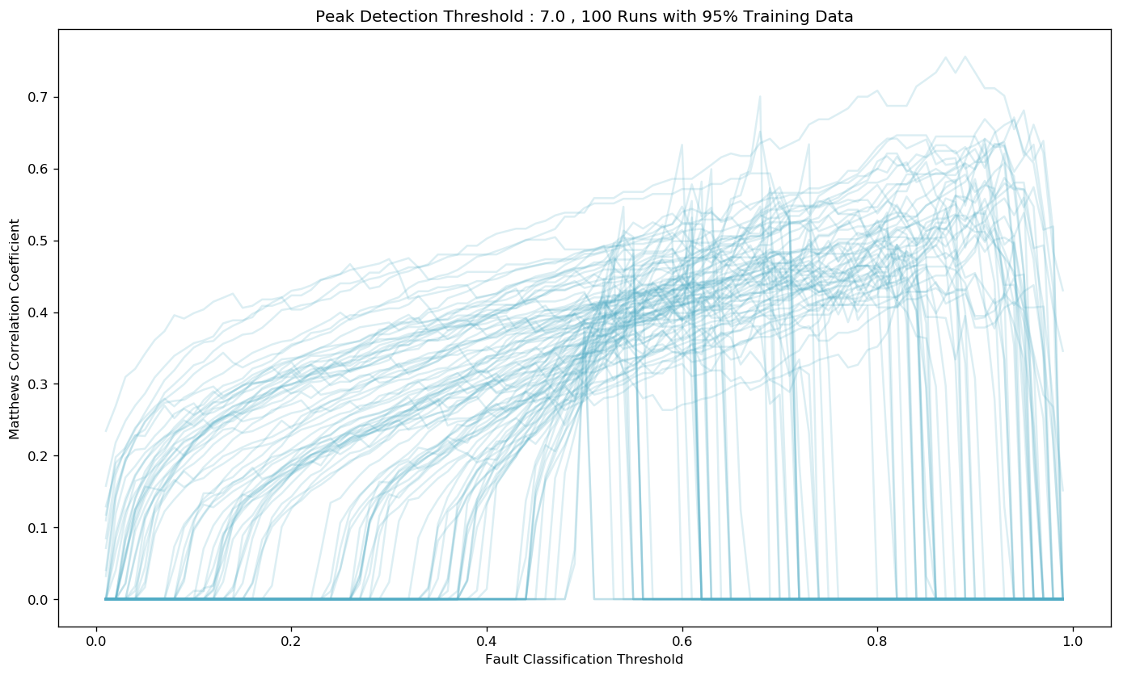
Concerns with Training/Test Splits on Unbalanced Data
Perform Monte Carlo trials that vary the random_state and test_size parameters in sklearn’s train_test_split function and assess the impact of different thresholds on performance.
The goal is to find and set thresholds for Peak Detection and Fault Classification that routinely yield higher Matthews Correlation Coefficient scores and are robust to varied divisions of the training data.
Notes:
Initial submissions proved less than spectacular, my localized training used a fixed random_state (my usual preference for repeatability) that happened to put me at the high end of these types of plots.
I has also used a standard 80-20 split, …
Goal here was to find some thresholds (both for peak detection and fault classification) that routinely yielded greater MCC scores and that was robust to varied splitting of the training data.

Slide 33
Revisiting Random Forest – Tuning for Unbalanced Classes
Use Ensemble k-Fold Cross-Validation
Splits the data into k parts, Take k-1 parts as training data and 1 part for validation
Train and predict with the model k times over, holding out a different part each time.
Ensemble output produces probability of sample belonging to a class, not assignment
Average and use the prediction probabilities from the k scores to assign a class
Set and Tune Class Weights
Enables cost-sensitive learning to remove a bias favoring the dominant class
Impose a costly penalty on minority class misclassification
Initially set weights based on ratios of data points in each class
Iterations on tailoring the weights can improve model performance
Adjust Thresholds on Classification Probabilities to Over/Under Predict a Class
Another method to improve minority class performance
Adjust probability thresholds for making a classification

